Slide 1
Shallow Neural Network and Deep Neural Network
主讲人：傅启明

Slide 2
Shallow Neural Network and Deep Neural Network
Shallow Neural Network

Slide 3




















Neural Network Overview
$$x_{1}$$
x
$$x_{2}$$
$$\hat{y}$$
w
$$z=w^{T}x+b$$
$$a=σ(z)$$
$$ℒ(a,y)$$
$$x_{3}$$
b
$$x_{1}$$
$$x_{2}$$
$$\hat{y}$$
x
$$x_{3}$$
$$W^{[1]}$$
$$z^{[1]}=W^{[1]}x+b^{[1]}$$
$$a^{[1]}=σ(z^{[1]})$$
$$z^{[2]}=W^{[2]}a_{ }^{[1]}+b^{[2]}$$
$$a^{[2]}=σ(z^{[2]})$$
$$ℒ(a^{[2]},y)$$
$$b^{[1]}$$
$$W^{[2]}$$
$$b^{[2]}$$

Slide 4
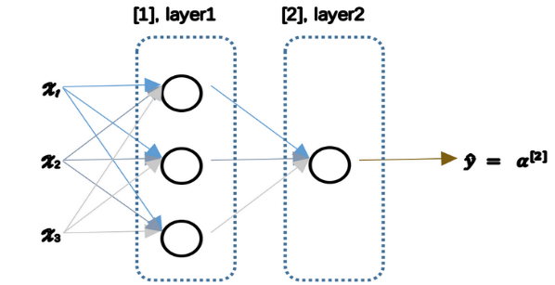
Neural Network Overview

Slide 5
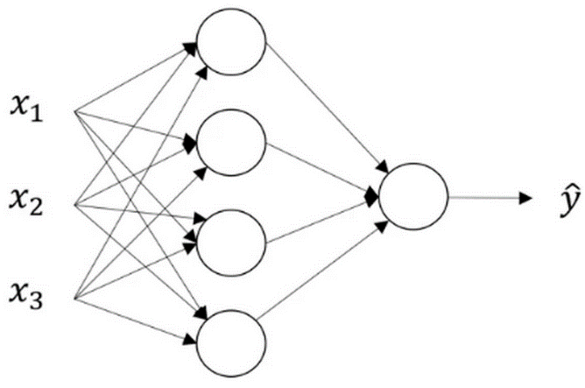
Neural Network Representation
Notes:
给出w，b的维度

Slide 6














Computing a Neural Network’s Output
$$x_{1}$$
$$x_{1}$$
$$x_{2}$$
$$w^{T}x+b$$
$$a=\hat{y}$$
$$σ(z)$$
$$x_{2}$$
$$\hat{y}$$
$$z$$
$$a$$
$$x_{3}$$
$$x_{3}$$
$$z=w^{T}x+b$$
$$a=σ(z)$$

Slide 7






Computing a Neural Network’s Output
$$x_{1}$$
$$x_{1}$$
$$x_{2}$$
$$\hat{y}$$
$$x_{2}$$
$$\hat{y}$$
$$x_{3}$$
$$x_{3}$$
$$z_{1}^{\left[1\right]}=w_{1}^{\left[1]T\right.}x+b_{1}^{\left[1\right]}$$
$$\left.z_{2}^{\left[1\right]}=w_{2}^{\left[1]T\right.}x+b_{2}^{\left[1\right]},a_{2}^{\left[1\right]}=σ(z_{2}^{\left[1\right]}\right)$$
$$\left.a_{1}^{\left[1\right]}=σ(z_{1}^{\left[1\right]}\right)$$
$$\left.a_{2}^{\left[1\right]}=σ(z_{2}^{\left[1\right]}\right)$$

Slide 8












Computing a Neural Network’s Output
$$a_{1}^{\left[1\right]}$$
$z_{1}^{\left[1\right]}=w_{1}^{{\left[1\right]T}^{ }}x+b_{1}^{[1]}, a_{ 1}^{[1]}=σ(z_{1}^{\left[1\right]}$)
$$x_{1}$$
$$a_{2}^{\left[1\right]}$$
$z_{2}^{\left[1\right]}=w_{2}^{{\left[1\right]T}^{ }}x+b_{2}^{[1]}, a_{ 2}^{[1]}=σ(z_{2}^{\left[1\right]}$)
$$x_{2}$$
$$\hat{y}$$
$$a_{3}^{\left[1\right]}$$
$z_{3}^{\left[1\right]}=w_{3}^{{\left[1\right]T}^{ }}x+b_{3}^{[1]}, a_{ 3}^{[1]}=σ(z_{3}^{\left[1\right]}$)
$$x_{3}$$
$$a_{4}^{\left[1\right]}$$
$z_{4}^{\left[1\right]}=w_{4}^{{\left[1\right]T}^{ }}x+b_{4}^{[1]}, a_{ 4}^{[1]}=σ(z_{4}^{\left[1\right]}$)

Slide 9
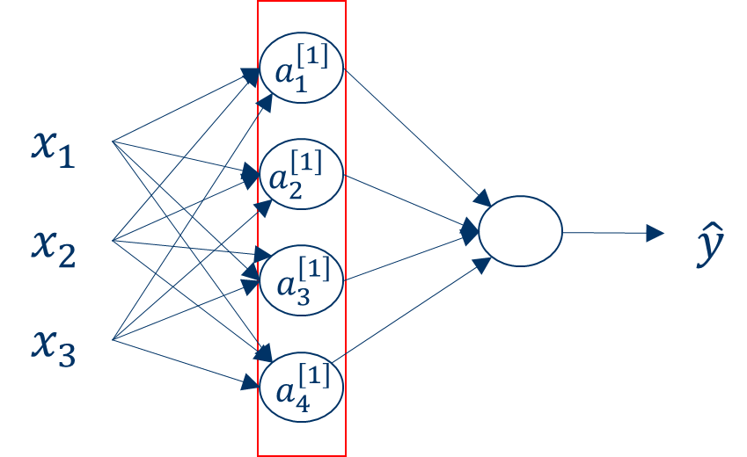




Computing a Neural Network’s Output
Vectorization Computing
$$z^{\left[n\right]}=w^{\left[n\right]T}x+b^{\left[n\right]}$$
$$a^{\left[n\right]}=σ\left(z^{\left[n\right]}\right)$$
$$\left[\begin{matrix}z_{1}^{\left[1\right]} \\ z_{2}^{\left[1\right]} \\ z_{3}^{\left[1\right]} \\ z_{4}^{\left[1\right]}\end{matrix}\right]=\overset{W^{\left[1\right]}}{\overbrace{\left[\begin{matrix}...W_{1}^{\left[1]T\right.}... \\ ...W_{2}^{\left[1]T\right.}... \\ ...W_{3}^{\left[1]T\right.}... \\ ...W_{4}^{\left[1]T\right.}...\end{matrix}\right]}}∗\overset{input}{\overbrace{\left[\begin{matrix}x_{1} \\ x_{2} \\ x_{3}\end{matrix}\right]}}+\overset{b^{\left[1\right]}}{\overbrace{\left[\begin{matrix}b_{1}^{\left[1\right]} \\ b_{2}^{\left[1\right]} \\ b_{3}^{\left[1\right]} \\ b_{4}^{\left[1\right]}\end{matrix}\right]}}$$
$$a^{[1]}=\left[\begin{matrix}a_{1}^{[1]} \\ a_{2}^{[1]} \\ a_{3}^{[1]} \\ a_{4}^{[1]}\end{matrix}\right]=σ\left(z^{\left[1\right]}\right)$$

Slide 10



Computing a Neural Network’s Output
$$a_{1}^{\left[1\right]}$$
$$x_{1}$$
$$z^{\left[2\right]}=W^{\left[2\right]}a^{\left[1\right]}+b^{\left[2\right]}$$
$$a_{2}^{\left[1\right]}$$
$$x_{2}$$
$$a_{}^{\left[2\right]}$$
$$\hat{y}$$
$$a_{3}^{\left[1\right]}$$
$$a^{\left[2\right]}=σ(z^{\left[2\right]})$$
$$x_{3}$$
$$a_{4}^{\left[1\right]}$$
Notes:
给出参数的维度

Slide 11


Computing a Neural Network’s Output
Given input x:
$$a_{1}^{\left[1\right]}$$
$$z^{\left[1\right]}=W^{\left[1\right]}x+b^{\left[1\right]}$$
$$x_{1}$$
$$a_{2}^{\left[1\right]}$$
$$x_{2}$$
$$a_{}^{\left[2\right]}$$
$$\hat{y}$$
$$a^{\left[1\right]}=σ(z^{\left[1\right]})$$
$$a_{3}^{\left[1\right]}$$
$$x_{3}$$
$$z^{\left[2\right]}=W^{\left[2\right]}a^{\left[1\right]}+b^{\left[2\right]}$$
$$a_{4}^{\left[1\right]}$$
$$a^{\left[2\right]}=σ(z^{\left[2\right]})$$
Notes:
给出参数的维度

Slide 12
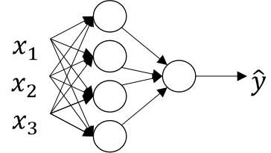
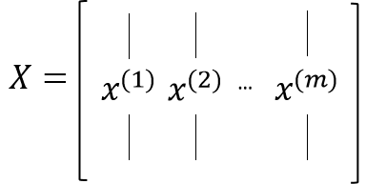
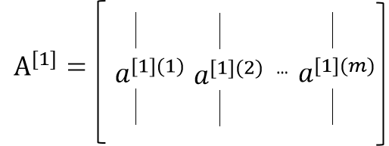
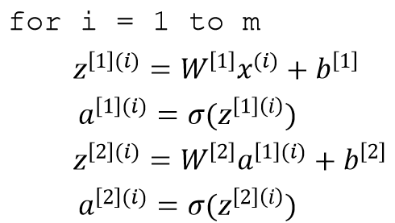
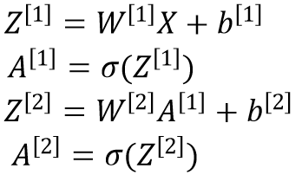
Vectorizing across multiple examples
Vectorizing:

Slide 13
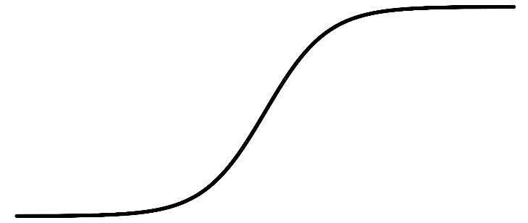





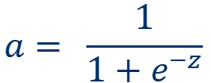

Activation functions
$$x_{1}$$
$$x_{2}$$
$$\hat{y}$$
$$x_{3}$$
a
Given x:
$$z^{\left[1\right]}=W^{\left[1\right]}x+b^{\left[1\right]}$$
$$a^{\left[1\right]}=σ(z^{\left[1\right]})$$
z
$$z^{\left[2\right]}=W^{\left[2\right]}a^{\left[1\right]}+b^{\left[2\right]}$$
$$a= \frac{1}{1+e^{−z}}$$
sigmoid:
$$a^{\left[2\right]}=σ(z^{\left[2\right]})$$

Slide 14
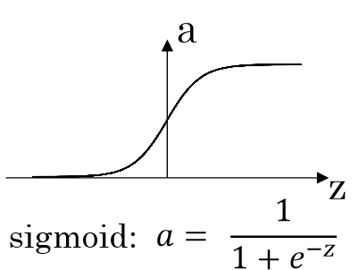
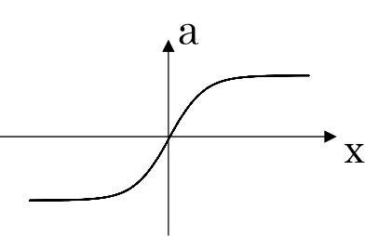
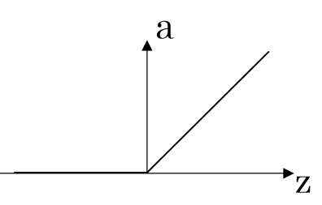
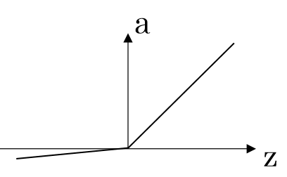



Activation functions
$$a= \frac{e^{z}−e^{−z}}{e^{z}+e^{−z}}$$
tanh:
ReLu:
$a=max(0,z)$
Leaky ReLu:
$a=max(0.01z,z)$

Slide 15
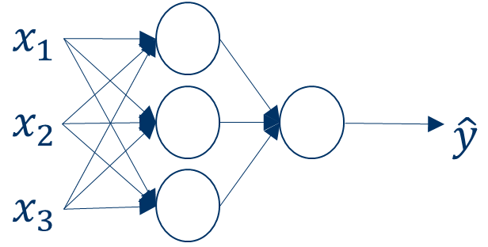

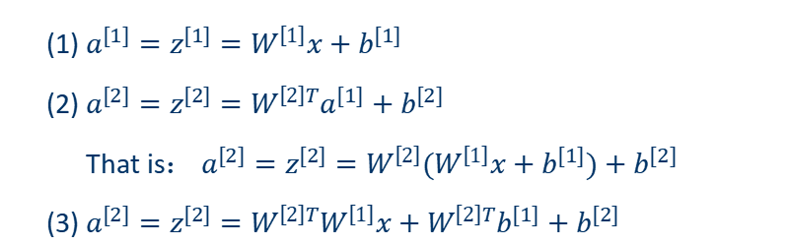

non-linear activation function? Why？
$$g(z)=z$$
Set：
(1) $a^{[1]}=z^{[1]}=W^{\left[1\right]}x+b^{[1]}$
(2) $a^{[2]}=z^{[2]}=W^{\left[2\right]T}a^{[1]}+b^{[2]}$
That is： $a^{[2]}=z^{[2]}=W^{\left[2\right]}(W^{\left[1\right]}x+b^{[1]})+b^{[2]}$
(3) $a^{[2]}=z^{[2]}=W^{\left[2\right]T}W^{\left[1\right]}x+W^{\left[2\right]T}b^{[1]}+b^{[2]}$
$$a^{\left[2\right]}=z^{\left[2\right]}=W^{′}x+b^{′}$$

Slide 16



Gradient descent for neural networks
Parameters:${ W}^{[1]}$，$b^{[1]}$，$W^{[2]}$，$b^{[2]}$
Cost function: $J(W^{[1]},b^{[1]},W^{[2]},b^{[2]})=\frac{1}{m}\sum_{i=1}^{m}{L}(\overset{^}{y},y)$
Gradient descent :
repeat:
$dW^{[1]}=\frac{dJ}{dW^{[1]}},db^{[1]}=\frac{dJ}{db^{[1]}}$
$$W^{\left[1\right]}⟹W^{\left[1\right]}−adW^{\left[1\right]},b^{\left[1\right]}⟹b^{\left[1\right]}−adb^{\left[1\right]}$$
$$dW^{\left[2\right]}=\frac{dJ}{dW^{\left[2\right]}},db^{\left[2\right]}=\frac{dJ}{db^{\left[2\right]}}$$
$$W^{\left[2\right]}⟹W^{\left[2\right]}−adW^{\left[2\right]},b^{\left[2\right]}⟹b^{\left[2\right]}−adb^{\left[2\right]}$$

Slide 17
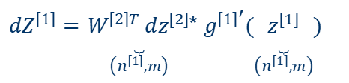
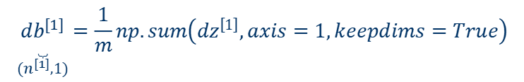


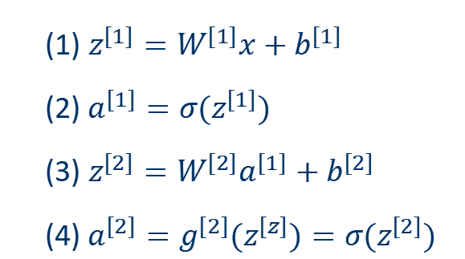
Gradient descent for neural networks
Formulas for computing derivatives：
forward propagation：
back propagation：
(1) $z^{[1]}=W^{[1]}x+b^{[1]}$
(2) $a^{[1]}=σ(z^{[1]})$
(3) $z^{[2]}=W^{[2]}a^{[1]}+b^{[2]}$
(4) $a^{[2]}=g^{[2]}(z^{[z]})=σ(z^{[2]})$
$$dz^{[2]}=A^{[2]}−Y,Y=\left[\begin{matrix}y^{[1]} & y^{[2]} & ⋯ & y^{[m]}\end{matrix}\right]$$
$$dW^{\left[2\right]}=\frac{1}{m}dz^{\left[2\right]}A^{\left[1]T\right.}$$
$dZ^{\left[1\right]}=\underset{\left(n^{\left[1\right]},m\right)}{\underset{⏟}{W^{\left[2\right]T} dz^{[2]}}}$* $g^{{\left[1\right]}^{′}}(\underset{\left(n^{\left[1\right]},m\right)}{\underset{⏟}{z^{[1]}}})$
$$dW^{\left[1\right]}=\frac{1}{m}dz^{\left[1\right]}x^{T}$$
$$\underset{(n^{[1]},1)}{\underset{⏟}{db^{[1]}}}=\frac{1}{m}np.sum\left(dz^{\left[1\right]},axis=1,keepdims=True\right)$$

Slide 18
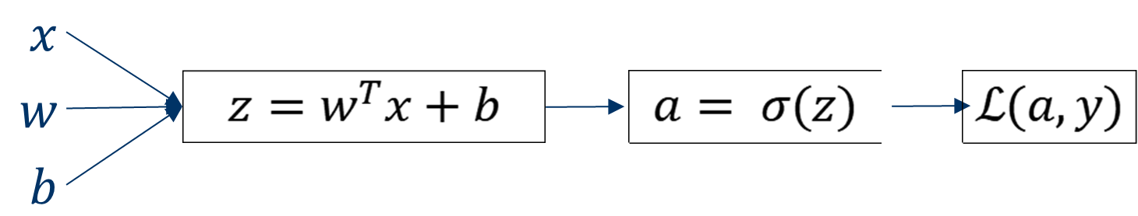

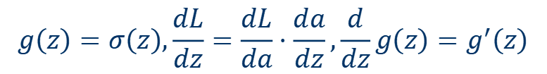

Backpropagation intuition
Logistic regression
$$da=\frac{d}{da}L\left(a,y\right)=(−ylogα−\left(1−y\right)log\left(1−a\right))′=−\frac{y}{a}+\frac{1−y}{1−a}$$
$$g\left(z\right)=σ\left(z\right),\frac{dL}{dz}=\frac{dL}{da}⋅\frac{da}{dz},\frac{d}{dz}g\left(z\right)=g^{′}\left(z\right)$$
$$dz=da⋅g^{′}\left(z\right)$$
$$dw=dz⋅x,db=dz$$

Slide 19
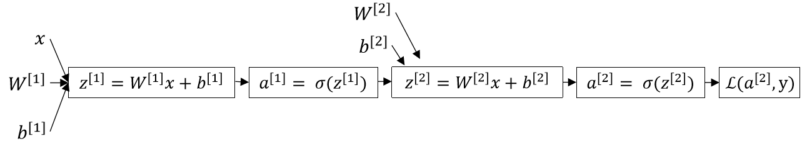
Backpropagation intuition
Neural network

Slide 20
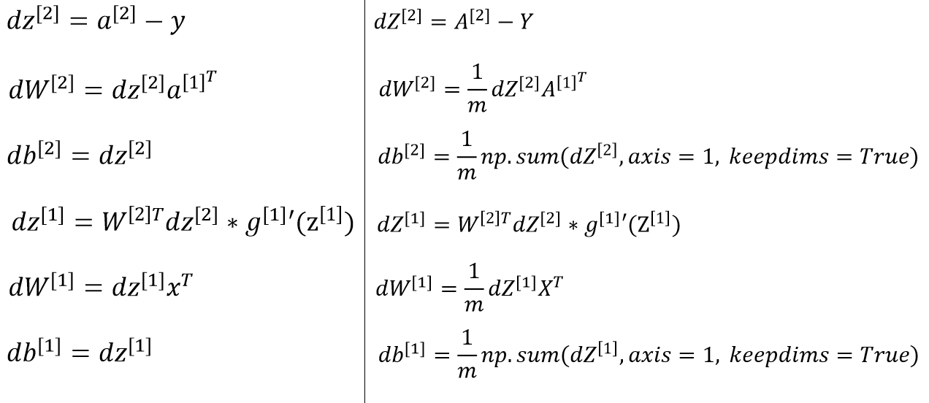
Backpropagation intuition
single example
multiple examples

Slide 21
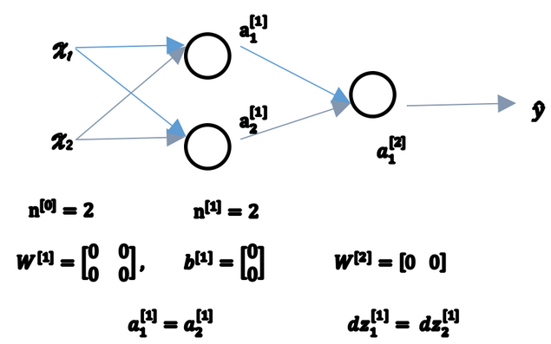
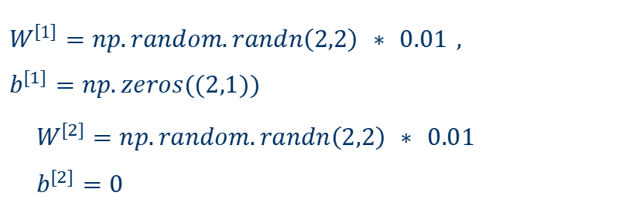
Random Initialization
Random Initialization:
$$W^{\left[1\right]}=np.random.randn\left(2,2\right) ∗ 0.01 ,$$
$b^{[1]}=np.zeros((2,1))$
$$W^{[2]}=np.random.randn\left(2,2\right) ∗ 0.01$$
$$b^{[2]}=0$$
Notes:
解释这里的0.01，主要是为后面激活函数准备的。

Slide 22
Shallow Neural Network and Deep Neural Network
Deep Neural Network

Slide 23
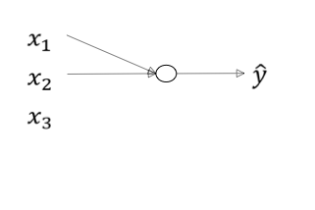
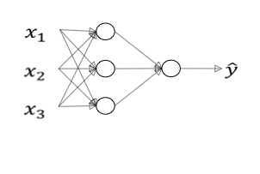

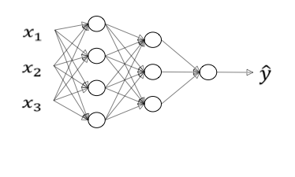
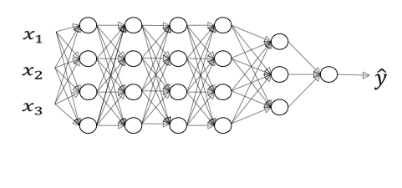
Deep L-layer neural network
logistic regression
1 hidden layer
2 hidden layers
5 hidden layers

Slide 24



Deep L-layer neural network
……
……
……
$$x_{1}$$
$$\hat{y}$$
$$x_{2}$$
N hidden layers

Slide 25
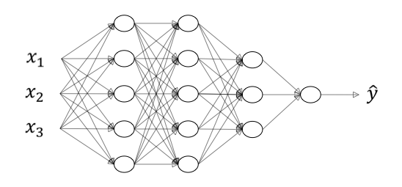







Deep L-layer neural network
$$n^{\left[0\right]}=n_{x}=3$$
$$n^{\left[1\right]}=5$$
$$n^{\left[2\right]}=5$$
$$n^{\left[3\right]}=3$$
$$n^{\left[4\right]}=n^{[L]}=1$$
$z^{\left[l\right]}$= $w^{\left[l\right]} a^{\left[l−1\right]}+$ $b^{\left[l\right]}$
$a^{\left[l\right]}=g(z^{\left[l\right]}$)

Slide 26





Deep L-layer neural network
$$n^{\left[0\right]}=n_{x}=3$$
$$n^{\left[1\right]}=5$$
$$n^{\left[2\right]}=5$$
$$n^{\left[3\right]}=3$$
$$n^{\left[4\right]}=n^{[L]}=1$$
$$a^{\left[l−1\right]}$$
$w^{\left[l\right]},$ $b^{\left[l\right]}$
$$z^{\left[l\right]}$$
$$g^{\left[l\right]}$$
$$a^{\left[l\right]}$$

Slide 27









Forward propagation in a Deep Network
Layer 1:
$$z^{\left[1\right]}=w^{\left[1\right]}x+b^{\left[1\right]}$$
$$\left.a^{\left[1\right]}=g^{\left[1\right]}(z^{\left[1\right]}\right)$$
Layer 2:
$$z^{\left[2\right]}=w^{\left[2\right]}a^{\left[1\right]}+b^{\left[2\right]}$$
$$\left.a^{\left[2\right]}=g^{\left[2\right]}(z^{\left[2\right]}\right)$$
……
Layer 4:
Vectorization：
$$z^{\left[4\right]}=w^{\left[4\right]}a^{\left[3\right]}+b^{\left[4\right]}$$
$$\left.a^{\left[4\right]}=g^{\left[4\right]}(z^{\left[4\right]}\right)$$
$$Z^{\left[l\right]}=W^{\left[l\right]}a^{\left[l−1\right]}+b^{\left[l\right]}$$
$$\left.A^{\left[l\right]}=g^{\left[l\right]}(Z^{\left[l\right]}\right)$$
Layer L:
($A^{[0]}=X)$
$z^{\left[l\right]}$= $w^{\left[l\right]} a^{\left[l−1\right]}+$ $b^{\left[l\right]}$
$a^{\left[l\right]}=g(z^{\left[l\right]}$)

Slide 28




matrix dimension
Need to keep the matrix dimension correct!
$w^{\left[l\right]}：{{(n}^{[l]}，n}^{[l−1]}$)
$b^{\left[l\right]}:$ ${(n}^{[l]}，1$)
$z^{\left[l\right]}$, $a^{\left[l\right]}:$ ${(n}^{[l]}，1$)
Vectorization：
$w^{\left[l\right]}：{{(n}^{[l]}，n}^{[l−1]}$)
$b^{\left[l\right]}:$ ${(n}^{[l]}，1$)
$$\left.Z^{\left[l\right]}=(z^{\left[l][1\right]}，z^{\left[l][2\right]}，z^{\left[l][3\right]}，…，z^{\left[l][m\right]}\right)$$
$A^{[l]}$：$(n^{[l]},m)$，$A^{[0]}=X=(n^{[l]},m)$

Slide 29







Building blocks of deep neural networks
Layer L:
Parameters: ${ W}^{[l]}$,$b^{[l]}$
Forward:
input: $a^{[l−1]}$
output: $a^{[l]}$
$z^{[l]}=W^{[l]}a^{[l−1]}+b^{[l]}$,$a^{[l]}=g^{[l]}(z^{[l]})$
Backward:
Cache $z^{[l]}$
Layer L
input: ${da}^{[l]}$
output: ${da}^{[l−1]}$
$dW^{[l]}$,$db^{[l]}$

Slide 30







Building blocks of deep neural networks
Layer L:
Layer L:
Parameters: ${ W}^{[l]}$,$b^{[l]}$
$$a^{[l−1]}$$
$W^{[l]}$,$b^{[l]}$
$$a^{[l]}$$
Forward:
input: $a^{[l−1]}$
Cache $z^{[l]}$
Cache $z^{[l]}$
output: $a^{[l]}$
$W^{[l]}$,$b^{[l]}$
Backward:
$${da}^{[l−1]}$$
$${da}^{[l]}$$
$${dz}^{[l]}$$
input: ${da}^{[l]}$
output: ${da}^{[l−1]}$
$${dw}^{[l]},{db}^{[l]}$$

Slide 31
























Building blocks of deep neural networks
$$a^{[0]}$$
$W^{[1]}$,$b^{[1]}$
$$a^{[1]}$$
$W^{[2]}$,$b^{[2]}$
$$a^{[2]}$$
……
$$a^{[L−1]}$$
$W^{[l]}$,$b^{[l]}$
$a^{[L]}$= $\overset{^}{y}$
Cache $z^{[1]}$
Cache $z^{[2]}$
Cache $z^{[L]}$
$W^{[1]}$,$b^{[1]}$
$W^{[2]}$,$b^{[2]}$
……
$W^{[L]}$,$b^{[L]}$
$${da}^{[0]}$$
$${da}^{[1]}$$
$${da}^{[2]}$$
$${da}^{[L−1]}$$
$${da}^{[L]}$$
$${dz}^{[1]}$$
$${dz}^{[2]}$$
$${dz}^{[L]}$$
$${dw}^{[1]},{db}^{[1]}$$
$${dw}^{[2]},{db}^{[2]}$$
$${dw}^{[L]},{db}^{[L]}$$
$$W=W−αdW$$
$$b=b−αdb$$

Slide 32



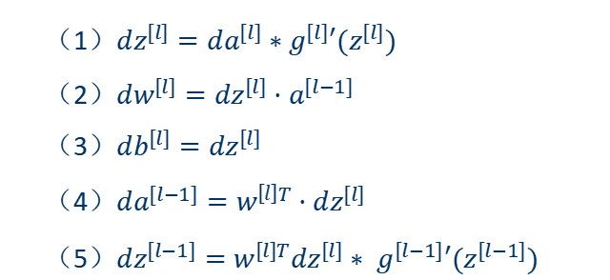

Forward and backward propagation
Forward Propagation:
backward Propagation:
input: $a^{[l−1]}$
input: ${da}^{[l]}$
output: $a^{[l]}$
Cache $z^{[l]}$
output: ${da}^{[l−1]}$
$,dW^{[l]}$,$db^{[l]}$
$$z^{\left[l\right]}=W^{\left[l\right]}⋅a^{\left[l−1\right]}+b^{\left[l\right]}$$
（1）$dz^{[l]}=da^{[l]}∗g^{[l]}′(z^{[l]})$
（2）$dw^{[l]}=dz^{[l]}⋅a^{[l−1]}$
（3）$db^{[l]}=dz^{[l]}$
（4）$da^{[l−1]}=w^{\left[l\right]T}⋅{dz}^{[l]}$
（5）$dz^{[l−1]}=w^{[l]T}dz^{[l]}∗ g^{[l−1]}′(z^{[l−1]})$
$$a^{\left[l\right]}=g^{\left[l\right]}\left(z^{\left[l\right]}\right)$$
Vectorization：
$$z^{\left[l\right]}=W^{\left[l\right]}⋅A^{\left[l−1\right]}+b^{\left[l\right]}$$
$$\left.A^{\left[l\right]}=g^{\left[l\right]}(Z^{\left[l\right]}\right)$$

Slide 33
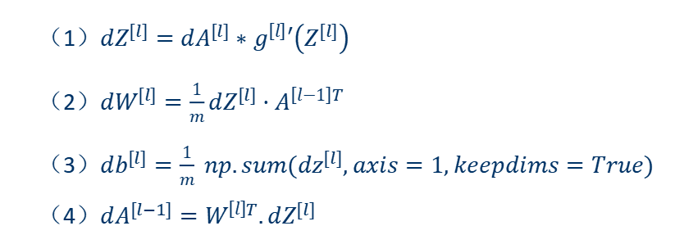
Forward and backward propagation
backward Propagation:
input: ${da}^{[l]}$
output: ${da}^{[l−1]}$
$,dW^{[l]}$,$db^{[l]}$
Vectorization：
（1）$dz^{[l]}=da^{[l]}∗g^{[l]}′(z^{[l]})$
（2）$dw^{[l]}=dz^{[l]}⋅a^{[l−1]}$
（3）$db^{[l]}=dz^{[l]}$
（4）$da^{[l−1]}=w^{\left[l\right]T}⋅{dz}^{[l]}$
（5）$dz^{[l−1]}=w^{[l]T}dz^{[l]}∗ g^{[l−1]}′(z^{[l−1]})$
（1）$dZ^{[l]}=dA^{[l]}∗g^{\left[l\right]}′\left(Z^{[l]}\right)$
（2）$dW^{[l]}=\frac{1}{m}dZ^{[l]}⋅A^{\left[l−1\right]T}$
（3）$db^{[l]}=\frac{1}{m} np.sum(dz^{[l]},axis=1,keepdims=True)$
（4）$dA^{[l−1]}=W^{\left[l\right]T}.dZ^{[l]}$

Slide 34
Parameters vs Hyperparameters
Parameters: variables obtained by learning from the model.
Hyperparameter: a parameter whose value is set before starting the learning process, rather than the parameter data obtained through training.
Notes:
通常情况下，需要对超参数进行优化，给学习机选择一组最优超参数，以提高学习的性能和效果。

Slide 35
Parameters vs Hyperparameters
Difference:
1. Different ways of obtaining
Parameters are obtained through model training
Hyperparameters are manually set.
2. Different influencing factors
Hyperparameters come from human experience and will be restricted by hardware.
parameters are mainly affected by the model. The training results of different models are different.
3. Different degrees of controllability
Hyperparameters are set artificially and have high controllability.
Parameters are related to the model, and the results sometimes fall short of expectations and have poor controllability.

Slide 36
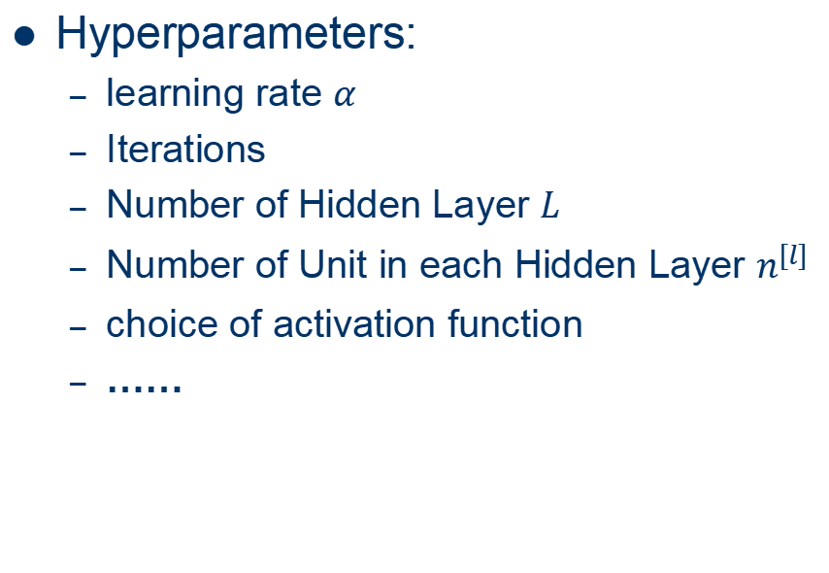
Parameters vs Hyperparameters
Hyperparameters:
learning rate $α$
Iterations
Number of Hidden Layer $L$
Number of Unit in each Hidden Layer $n^{[l]}$
choice of activation function
……
Parameters:
W,b

Slide 37

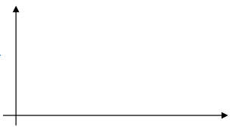
Parameters vs Hyperparameters
How to choose Hyperparameters?
Idea
cost 𝐽
# of iterations
Experiment
Code

Slide 38
To be Continued

